Slide 1
Cryptocurrency trend prediction using Machine Learning
By- Group No. 20
BT18MEC030 VIDHYA SHREE
BT18MEC077 P V KARTHIKEYA BHARADWAJ
BT18MEC078 KSHITIJA KHARAT
BT18MEC152 AAKANKSHA LOTE
BT19MME068 DIVYA PACHBHAI

Slide 2
Introduction
Cryptocurrency is a new sort of asset that has emerged as a result of the advancement of financial technology and it has created a big opportunity for researches. Cryptocurrency price forecasting is difficult due to price volatility and dynamism. Bitcoin and other cryptocurrencies are becoming increasingly popular among investors. The aim of this work is to study the trend on day-to-day variations in the cryptocurrency price, as well as providing information on cryptocurrency price patterns. Using the dataset, machine learning module is introduced for prediction of price values. The importance of having these models is that they can have significant economic ramifications by helping investors and traders to pinpoint cryptocurrency sales and purchasing.

Slide 3

Problem Description
Due to the difficulty of projecting cryptocurrency prices due to price volatility and dynamism, we plan to use a machine learning algorithm on the collected data set to anticipate the trajectory of multiple cryptocurrencies.

Slide 4
Literature Review
Title: Forecasting and trading cryptocurrencies with machine learning under changing market conditions
Authors: Helder Sebastião and Pedro Godinho.
The paper examines the predictability of three major cryptocurrencies: bitcoin, ethereum, and litecoin, and the profitability of trading strategies devised upon ML, namely linear models, RF, and SVMs.The paper studies the models validated in a period characterized by unprecedented turmoil and tested in a period of bear markets, allowing the assessment of whether the predictions are good even when the market direction changes between the validation and test periods. For each model class, the set of variables that leads to the best performance were chosen according to the average return per trade during the validation sample. Different set of input variables and hyperparameters are selected and the forecasting ability of these models are studied. The forecasting accuracy of the individual models seems low, hence model assembling is used which gives the better outcomes.

Slide 5
Literature Review
Title: A Novel Cryptocurrency Price Prediction Model Using GRU, LSTM and bi-LSTM Machine Learning Algorithms
Authors: Mohammad J. Hamayel and Amani Yousef Owda.
Around the world, there are hundreds of cryptocurrencies that are used. It is a highly volatile market and because of this it is very difficult to predict the prices. This paper has gone through three types of recurrent neural network (RNN) algorithms used to predict the prices of three types of cryptocurrencies, namely Bitcoin (BTC), Litecoin (LTC), and Ethereum (ETH). The mean absolute percentage error (MAPE) is calculated and the three different methods' MAPE has been compared. The three methods were long short-term memory(LSTM), bidirectional LSTM (bi-LSTM) and gated recurrent unit. The dataset was collected on a daily basis from 1 January 2018 to 30 June 2021. When the results were compared it was found that GRU was the method with the least MAPE, while bi-LSTM has the lowest prediction result as compared to other two methods.

Slide 6
Literature Review
Title: Bitcoin Price Prediction Using Machine Learning and Artificial Neural Network Model
Authors: Alvin Ho1, Ramesh Vatambeti, Sathish Kumar Ravichandran
Cryptocurrency is presently hot topic in the market as many investors are showing the interest towards it. But crypto market is very volatile and dynamic, thus predicting the trend is in high demand. This paper compares the result obtained from Long Short- Term Memory (LSTM) model of Recurrent Neural Network and Linear Regression model of Machine learning technique. The data set used was from August 2017 to August 2020, from this various features like open, low, high, close, volume BTC, volume USDT, Date and symbol were selected. Later on with the help of data visualization libraries, it was observed that the relation between ”Volume of USDT” and ”Volume of BTC” with the other features is not clear and therefore they were removed from the data set. Algorithm used were Linear Regression technique using method of least square to get the best fit line and the obtained accuracy was 99.97% whereas Using LSTM technique error of approximately 0.08% was observed. Thus the model shows better prediction rate using LSTM technique.

Slide 7
Methodology
Literature survey
Dataset collection
Model Training
Model selection
Analysis of predicted results
.
1
2
3
4
5

Slide 8
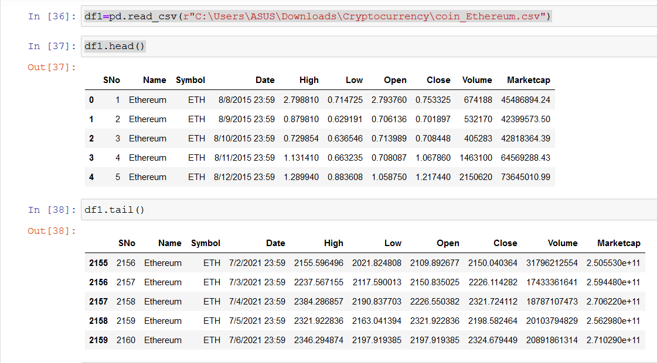
Dataset

Slide 9
Features of Dataset
Feature | Description
Date | The time and date at which each instance or entry has been collected from crypto-currency stock market
Open Price | Open price for each day according to each date
High Price | Highest price on that day in which data has been collected.
Low Price | Lowest price on that day in which data has been collected.

Slide 10
Features of Dataset
Feature | Description
Close Price | Final price of currency on that day on which data has been collected.
Volume of BTC | Turnovers in the price of BTC
Volume of Currency | Turnovers in the price of exchange rates of currencies
Marketcap | Price of a stock by its total number of outstanding shares

Slide 11
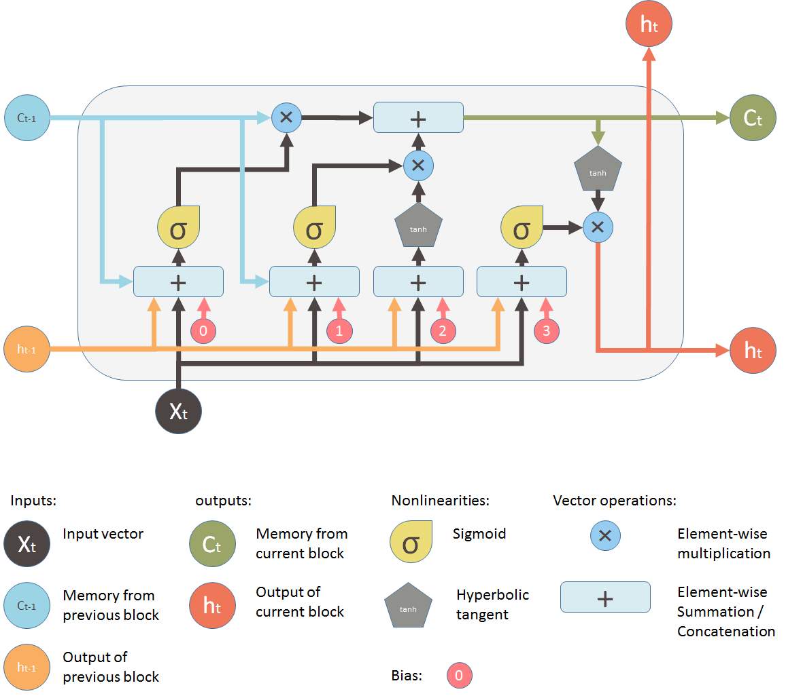
Why LSTM?
Long short term memory is artificial recurrent neural network architecture use in Deep learning.
LSTM Models are able to store information over a period of time this characteristic is extremely useful for time series or sequential data.
It should be noted that LSTM can remember important information and forget irrelevant information.

Slide 12
References
1)Forecasting and trading cryptocurrencies with machine learning under changing market conditions Helder Sebastião* and Pedro Godinho,Innov (2021) 7:3 (https://doi.org/10.1186/s40854-020-00217-x)
2)A Novel Cryptocurrency Price Prediction Model Using GRU,LSTM and bi-LSTM Machine Learning Algorithms Mohammad J. Hamayel and Amani Yousef Owda * (https://doi.org/10.3390/ai2040030)
3)Bitcoin Price Prediction Using Machine Learning and Artificial Neural Network Model Alvin Ho1, Ramesh Vatambeti1∗, Sathish Kumar Ravichandran1 (https://doi.org/10.17485/IJST/v14i27.878)
4)Dataset: (https://www.kaggle.com/sidhartharya/wazirx-cryptocurrency-data?select=bandusdt.csv)

Slide 13
Thank You

